Slide 1
QML for LHCb: distinguish real tracks from ghosts
Supervisors: Menica Dibenedetto, Miriam Lucio Martinez, and Davide Nicotra
Group 10

Slide 2
Team
Vasileios Chaidas
Dimitris Feizai
Raghav Naidu
Gilles Salem
Eliott Simon

Slide 3
Outline
Problem Introduction
Data
Approach
Results
Discussion and Conclusion

Slide 4
Problem Introduction

Slide 5
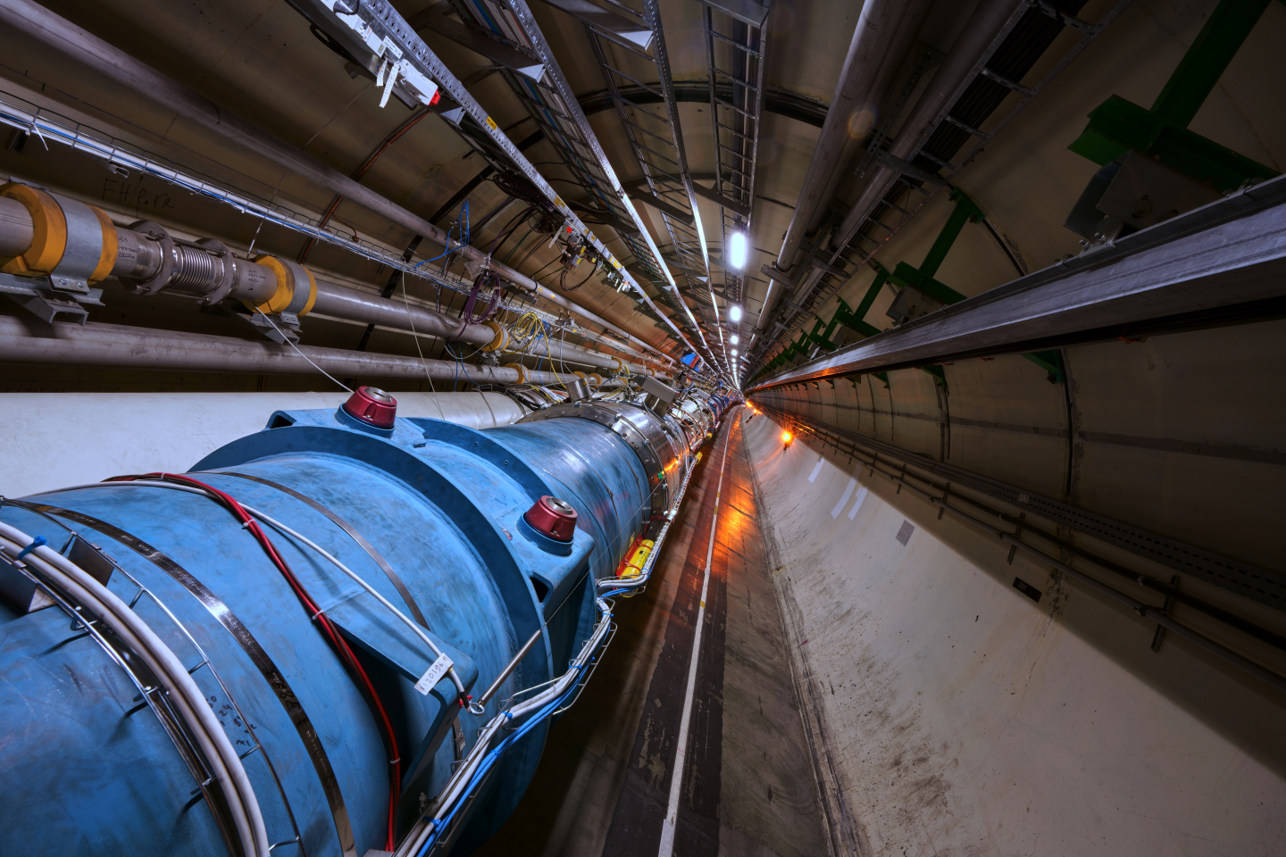
Large Hadron Collider beauty (LHCb)
LHCb: One of the eight particle physics detector experiments collecting data at the Large Hadron Collider at CERN
Large Hadron Collider:
Largest and most powerful particle accelerator in the world
27-kilometre long
Particles reach a speed close to the speed of light
Magnets kept at a temperature as low as ‑271.3°C
Large Hadron Collider (source: home.cern)

Slide 6
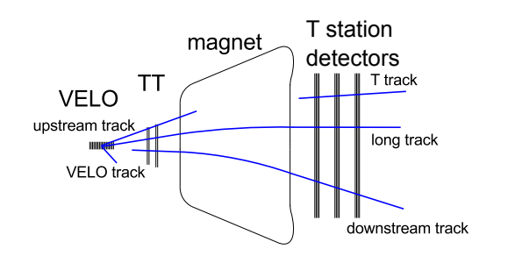
The LHCb Experiment:
In this project we will only focus on the Tracking Detectors and the corresponding tracking system:
Different “hits” left by charged particles in the corresponding detectors are combined into trajectories (tracks) and then propagated mathematically through the magnetic field with the help of a Kalman Filter.
Outlay of the LHCb tracking system along with different types of tracks

Slide 7
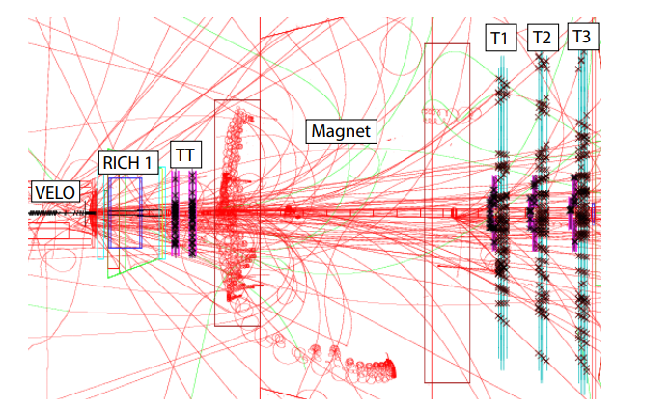
Real Tracks and Ghost Tracks
Since each event contains a huge number of hits and possible track combinations, the track-reconstruction method is prone to errors. Those erroneous tracks are called Ghost Tracks
Ghost Tracks: Pseudocombinations of hits that are wrongly interpreted as tracks while in reality they are formed by random hits from different particles.
A typical event will contain a huge number of hits and tracks making the reconstruction attempt more complicated and difficult.
Notes:
Vasilis

Slide 8
Real Tracks and Ghost Tracks
The goal and focus of this project is to develop an algorithm that will efficiently and reliable be able to distinguish ghost tracks from real tracks
Specifically we would like to investigate a Quantum Machine Learning (QML) approach and see how we can implement breakthroughs into this new upcoming field to tackle our problem.
A typical event will contain a huge number of hits and tracks making the reconstruction attempt more complicated and difficult.

Slide 9
Research questions
The following research questions were posed on Phase 1:
Can we create and implement a working QSVM to our problem?
Are QSVM yet practical to implement in real problems?
Do quantum algorithms outperform classical classification methods in distinguishing real tracks from ghosts?

Slide 10
Research questions
How different data embedding methods affect our model's results and performance?
Which embedding method yields the best results for our model? Can we explain why?
If our QSVM is working can we derive meaningful results for our problem?

Slide 11
Data

Slide 12
Data
The simulated data of a track has corresponding information about it:
Label - Real or Ghost
x,y,z coordinates
7 features associated with each track which are: “tx” ,”ty” ,”ndof” ,”chi2” , “ip_chi2”, “nb_hits” and “qop”

Slide 13
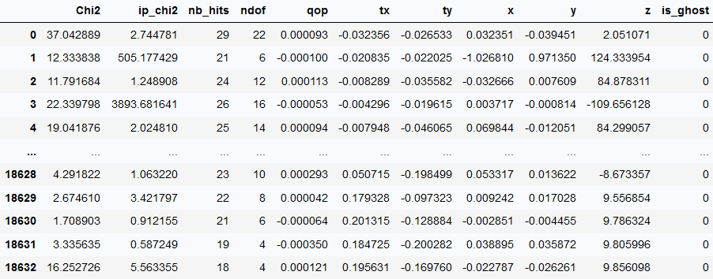
Data

Slide 14
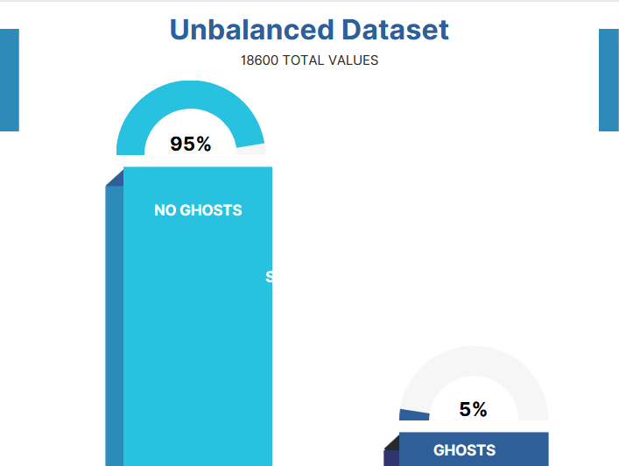

Slide 15
Data Pre-processing
Preprocessing :
Normalization
Balancing uneven data
Removing outliers

Slide 16
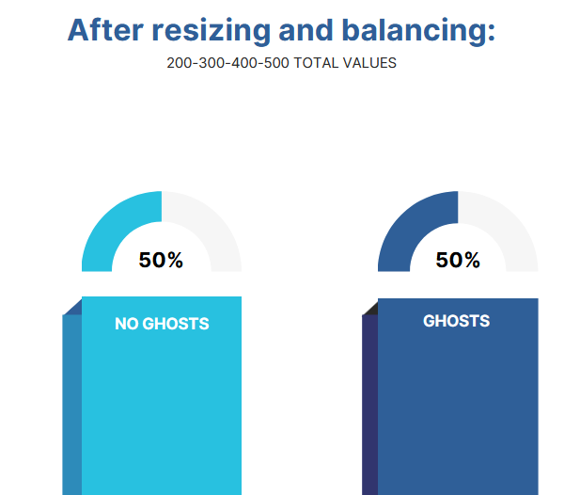

Slide 17
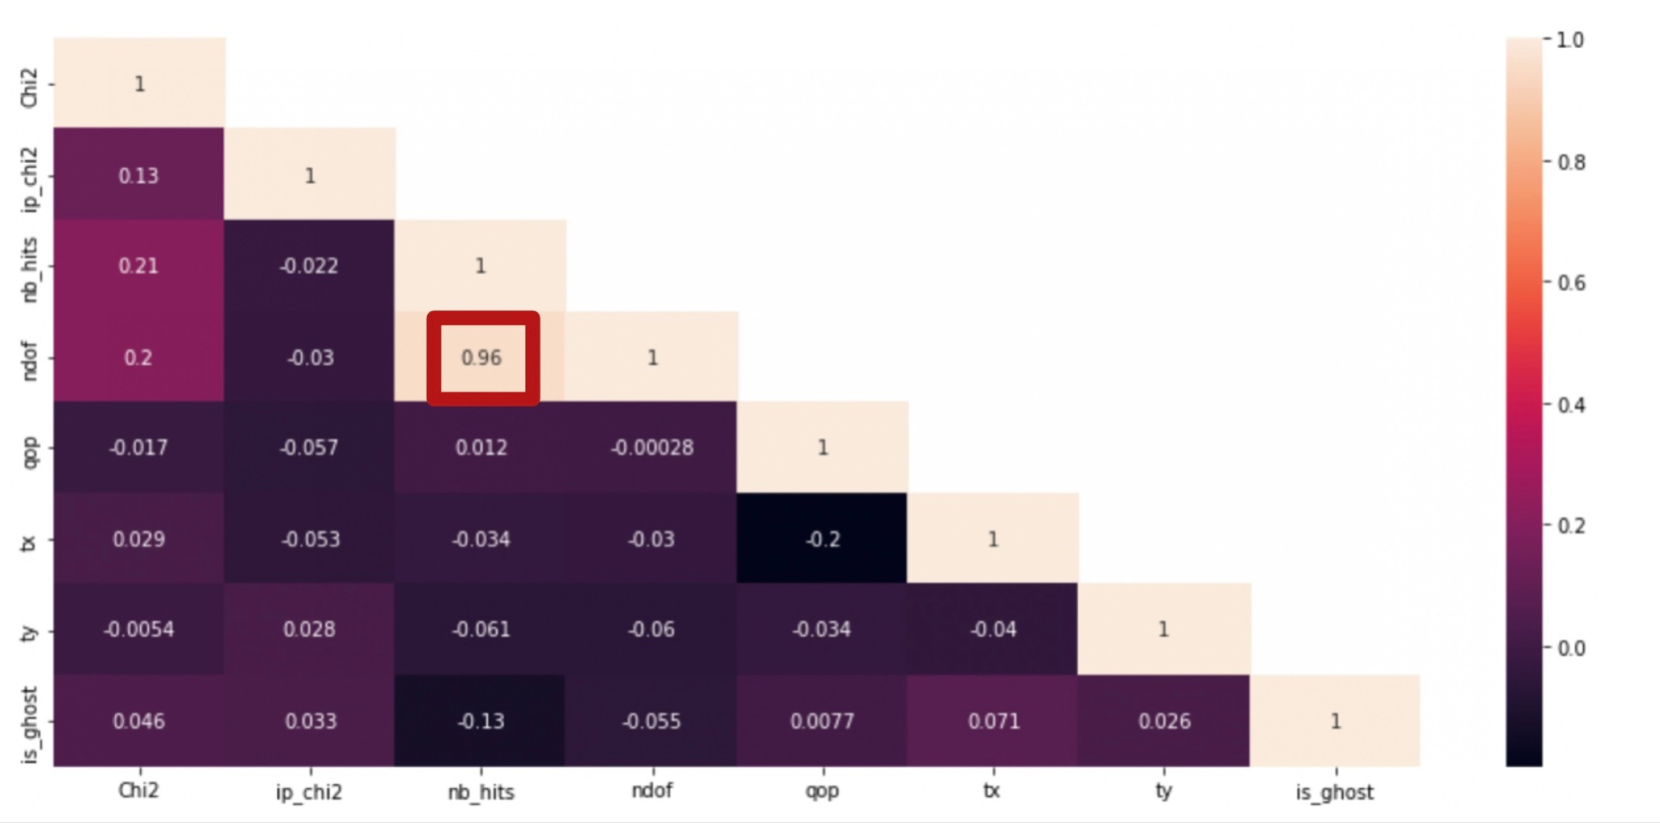
Data Preprocessing

Slide 18
Approach

Slide 19
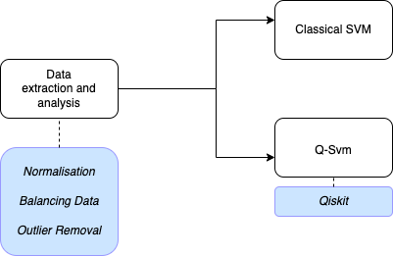
Pipeline

Slide 20
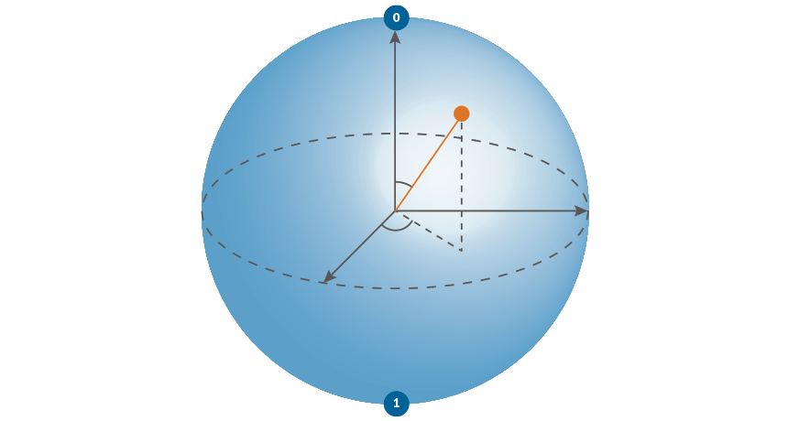
Quantum-enhanced Support Vector Machine
Data Point
Qubits
tx
ty
nb_hits
chi2
ipchi2
qop
Quantum SVM

Slide 21
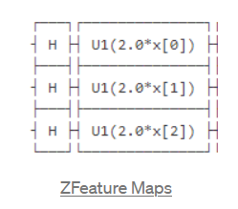
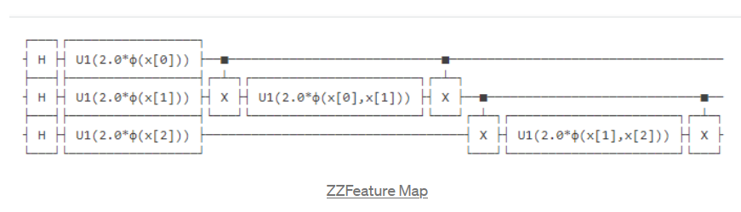
Quantum Feature Map
Feature maps used:
ZFeature Map
ZZFeature Map
Pauli’s Feature Map

Slide 22
QSVM Implementation
Reduce dataset
Use of ZZFeatureMap data encoding circuit
BasicAer “qasm_simulator”
Qubits used : 6
20

Slide 23
Results

Slide 24
QSVM Hyperparameters:
-Feature Maps
-Dataset size
-Class Ratio (Ghost/Real)
Train/test/validation —> 80/10/10

Slide 25
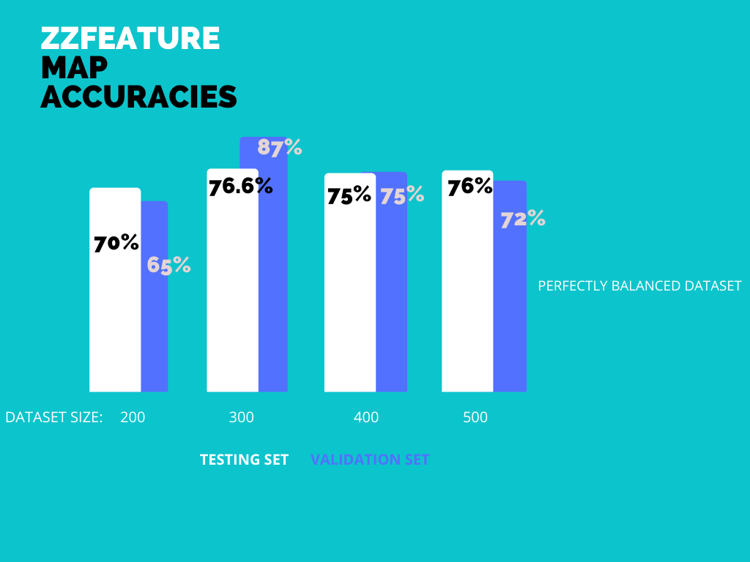

Slide 26
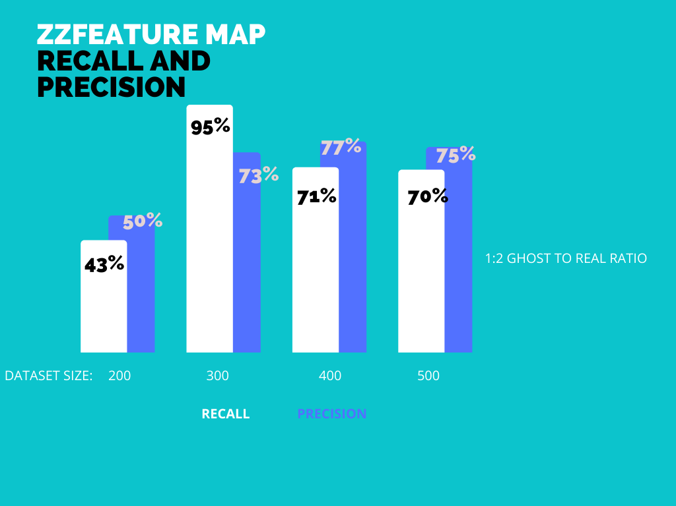

Slide 27
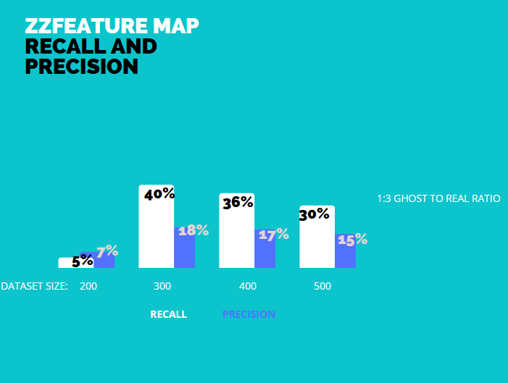

Slide 28
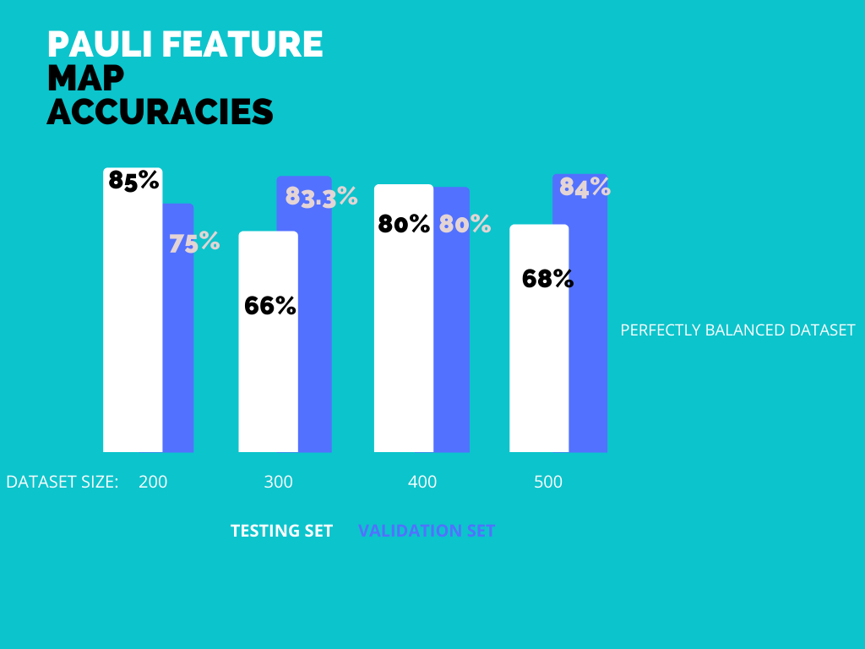

Slide 29
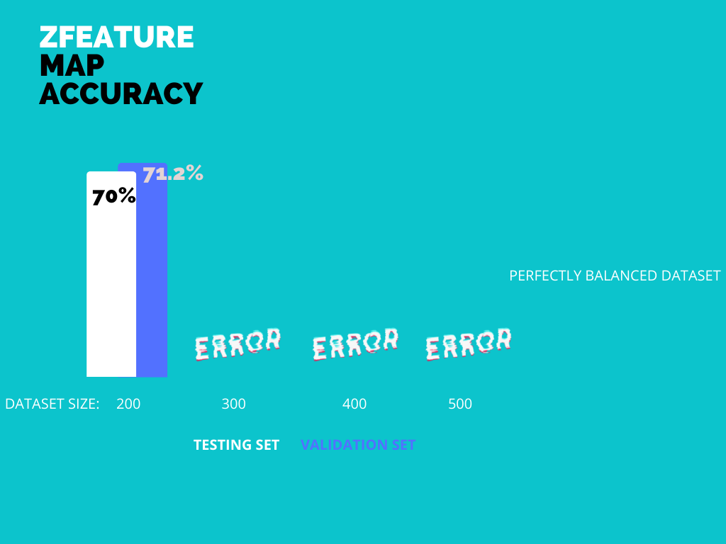

Slide 30
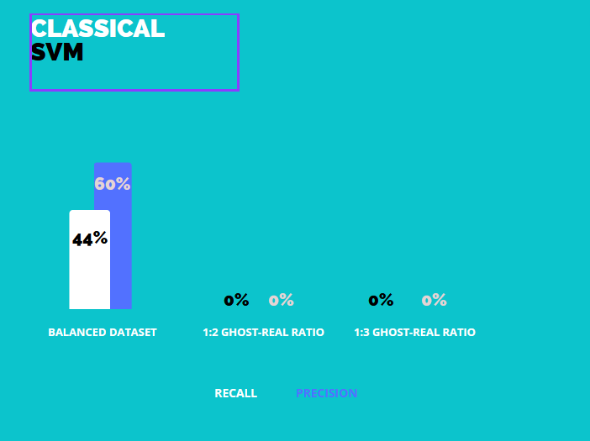

Slide 31
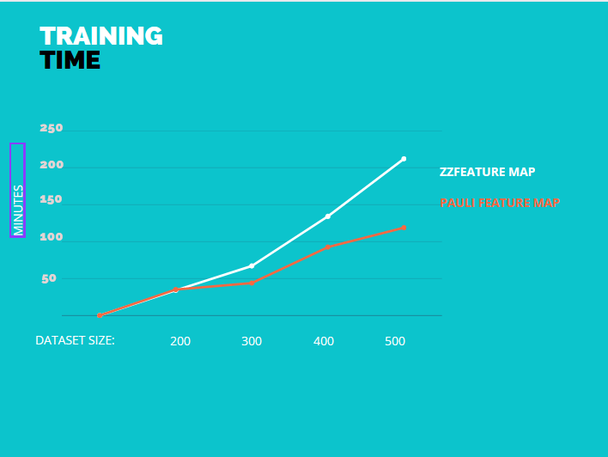

Slide 32
5. Discussion and conclusion

Slide 33
Research questions
The following research questions were posed on Phase 1:
Can we create and implement a working QSVM to our problem?
Are QSVM yet practical to implement in real problems?
Do quantum algorithms outperform classical classification methods in distinguishing real tracks from ghosts?

Slide 34
Research questions
How different data embedding methods affect our model's results and performance?
Which embedding method yields the best results for our model?
If our QSVM is working can we derive meaningful results for our problem?

Slide 35
Challenges
Size of Dataset
Lack of in depth knowledge in field of Quantum Machine Learning
Using older version of Qiskit 0.24.1

Slide 36
Future work
Working with the updated version of Qiskit.
To test models on complete dataset.
To check if inherent stochastic nature of experiments have a impact on results.
Working with Pennylane library.
Working with real with datasets.

Slide 37
References
PennyLane website, pennylane.ai
Quantum Machine Learning 102 — QSVM Using Qiskit, Shubham Agnihotri,https://shubham-agnihotri.medium.com/quantum-machine-learning-102-qsvm-using-qiskit-731956231a54
Quantum-enhanced Support Vector Machine (QSVM) https://qiskit.org/documentation/stable/0.24/tutorials/machine-learning/01-qsvm-classification.html?fbclid=IwAR3aI1OSuD3Yzfpx-3MEOEExpExrKLk6D5rABtLbVmlbkfMwUa9wlvxxCmg
Quantum Machine Learning 102 — QSVM Using Qiskit https://shubham-agnihotri.medium.com/quantum-machine-learning-102-qsvm-using-qiskit-731956231a54
"Qiskit", Wikipedia

Slide 38
Thank you for your attention
Any Questions?

